Slide 1
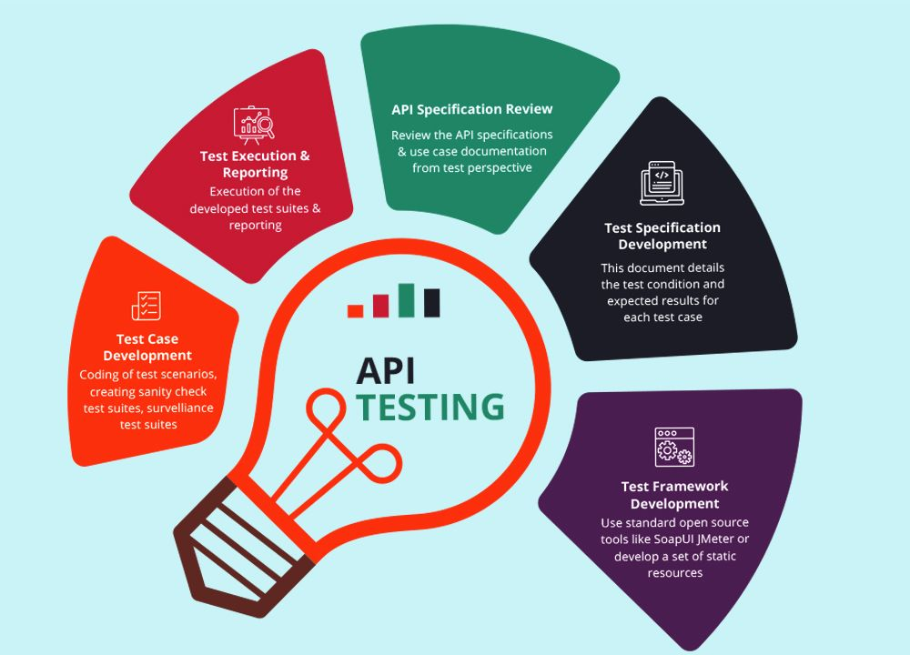

Slide 2
Importance of API Testing
Definition: API testing is a type of software testing that focuses on verifying the functionality, performance, security, and reliability of APIs
Purpose: Ensures that APIs meet requirements, handle various inputs and outputs correctly, and perform as expected under different conditions

Slide 3
Types of API Testing
Functional Testing: Verify API functionality, endpoints, request/response formats, input validations, and error handling
Integration Testing: Test API interactions with other components, systems, databases, and third-party services
Performance Testing: Evaluate API performance, response times, throughput, scalability, and resource utilization
Security Testing: Identify and mitigate security vulnerabilities, authentication flaws, data exposure risks, and access control issues
Load Testing: Measure API performance under load, simulate concurrent users, requests, and stress conditions
Regression Testing: Ensure that API changes or updates do not break existing functionality, contracts, or integrations

Slide 4
API Testing Techniques
Black Box Testing: Test APIs without knowledge of internal code or implementation details, focusing on inputs, outputs, and behavior
White Box Testing: Test APIs with knowledge of internal code, structures, and logic, enabling targeted testing of specific paths and edge cases
Boundary Value Analysis: Test API inputs at boundaries and limits to identify boundary conditions, edge cases, and potential errors
Equivalence Partitioning: Divide API input data into equivalent partitions or classes to reduce test cases and cover representative scenarios
Positive/Negative Testing: Test API functionality with valid inputs (positive testing) and invalid inputs (negative testing) to assess error handling and validation
Exploratory Testing: Discover defects, corner cases, and unexpected behaviors in APIs through exploratory testing techniques and ad-hoc testing

Slide 5
API Testing Tools
Postman: Postman tool for API development, testing, automation, and collaboration with features like collections, environments, and testing scripts
SoapUI: SoapUI tool for functional testing, load testing, and security testing of SOAP and RESTful APIs with a graphical interface
JMeter: Apache JMeter tool for load testing, performance testing, and stress testing of APIs, web applications, and services
Katalon Studio: Katalon Studio tool for API testing, automation, and integration with testing frameworks like Selenium for end-to-end testing
REST Assured: REST Assured library for Java for testing RESTful APIs, validating responses, and writing API tests in a fluent, expressive manner
Swagger Inspector: Swagger Inspector tool for testing APIs directly from OpenAPI or Swagger specs, generating test cases, and validating API behavior

Slide 6
API Testing Best Practices
Test Coverage: Design comprehensive test suites covering functional, integration, performance, security, and edge cases
Automation: Automate API tests for regression testing, continuous integration (CI), and continuous testing (CT) using testing frameworks and tools
Data-Driven Testing: Use data-driven testing approaches with varied inputs, payloads, and scenarios to validate API behavior and responses
Mocking and Stubs: Use mock servers, stubs, or virtualization for testing APIs in isolation, simulating responses, and handling dependencies
Environment Management: Manage test environments (dev, QA, staging, production) for consistent testing, data isolation, and environment-specific configurations
Security Testing: Include security testing in API test cases, validate authentication mechanisms, encryption, access controls, and API security policies

Slide 7
API Testing Challenges
Dependency Management: Testing APIs with dependencies on external services, databases, or components can be challenging to manage and simulate
Versioning and Compatibility: Testing API versions, backward compatibility, deprecated features, and migration paths across different environments
Dynamic Data and State: Testing APIs with dynamic data, stateful interactions, session management, and transactional behavior
Security Concerns: Identifying and addressing security vulnerabilities, data privacy risks, authorization issues, and compliance requirements
Concurrency and Performance: Testing APIs under concurrent requests, load conditions, spikes in traffic, and performance bottlenecks
Error Handling: Validating error responses, status codes, error messages, and handling edge cases in error scenarios

Slide 8
API Testing Strategies
Test Planning: Define API testing objectives, scope, test scenarios, test data, and acceptance criteria in test plans
Test Execution: Execute API tests manually or automate them using testing frameworks, tools, and CI/CD pipelines
Test Validation: Validate API responses, status codes, payloads, and expected behaviors against defined test cases and requirements.
Test Reporting: Generate test reports, logs, and metrics to track test coverage, defects, performance metrics, and testing progress
Regression Testing: Perform regression testing after API changes, updates, bug fixes, or new feature implementations to ensure stability/compatibility
Exploratory Testing: Explore APIs dynamically, interactively, and iteratively to discover defects, anomalies, and unexpected behaviors

Slide 9
API Testing Metrics and Monitoring
Response Times: Measure API response times, latency, and processing times under normal and peak loads
Throughput: Monitor API throughput, request rates, concurrency, and resource utilization during load testing
Error Rates: Track API error rates, error codes, error messages, and error handling effectiveness in production environments
API Availability: Monitor API uptime, availability, downtime incidents, and service level agreements (SLAs)
Performance Trends: Analyze performance trends, anomalies, regressions, and optimizations over time with historical data

Slide 10
API Testing Metrics and Monitoring
contd…
Security Incidents: Detect and respond to security incidents, suspicious activities, API abuse, and unauthorized access attempts
API Usage Analytics: Gather insights into API usage patterns, popular endpoints, user behaviors, and API performance impact on applications

